Slide 1
Data Analytics – Lesson 10 Applications for Data Analytics
Jeffrey Strickland, Ph.D.

Slide 2

What is Required by Data Analytics?
Integrate
Analyze
Visualize
V1 | V2 | V3 | V4
1 | 14.23 | 1.71 | 2.43
1 | 13.20 | 1.78 | 2.14
1 | 13.16 | 2.36 | 2.67
1 | 14.37 | 1.95 | 2.50
1 | 13.24 | 2.59 | 2.87
https://portal.azure.com/#dashboard/private/6245138c-3a35-4e4f-8cf6-d8fe27b9b026

Slide 3
ZeroR
Predictive Modeling Procedures Didactic
One R
Naïve Bayesian
Decision Tree
Linear Discriminant Analysis
Data
Classification
Logistic Regression
Dataset
K Nearest Neighbors
Data Preparation
Database
Artificial Neural Network
ETL
Support Vector Machine
VOI
Decision Tree
Modeling Steps
Regression
Multiple Linear Regression
K Nearest Neighbors
Artificial Neural Network
Support Vector Machine
Agglomerative
Divisive
Clustering
K-Means
Association Rules
Self Organizing Map

Slide 4
Modeling Steps
Define the right problem
Gather and Analyze Data
Gather and Analyze additional Data
Start Data Reduction
Determine missing percentages
Determine Value of Information (VOI)
Use VOI metrics to further reduce data
Run test for and examine collinearity
Determine you functional form
Build your model
Examine your model results
Run the model with model variable only
Develop validation code
Perform out-of-time testing
Evaluate the model performance
Develop you model documentation
Develop production code
Implement model
Monitor Performance
Model V&V

Slide 5
1. Define the right problem
In Making Analysis Relevant, Mr. Vince Roske & John D. Robinson, MG USA, Retired¹³ propose a series of questions we as analysts should ask:
What’s the question?
What’s the real question?
What do the final slides look like?
What do I already know?
How do I get the remaining information that I need?
After defining the problem…the right problem… determine the target variable and develop the code to retrieve it.
Requires a peer review.
Identify the right target variable
If someone else give you the target audience, do not blindly accept it.
In God we trust, everything else we check.

Slide 6
2. Gather and Analyze Data
Get customer attributes and behaviors from a variety of reliable data sources
Study the data to determine is (at first glance) is will be useful in solving your problem
Use the modeler intuition/judgment test
Data
Dataset
Database
Data Preparation
ETL
VOI

Slide 7
Data Preparation
Data preparation may be the most time consuming part of your project
Data preparation is heavily prone to errors.
The success of data mining projects heavily depends on the quality of the prepared data.
Build a dataset from one or more data sources to be used for exploration and modeling.
Start with an initial dataset to get familiar with the data
Use it to discover first insights into the data and have a good understanding of any possible data quality issues.
The old saying "garbage-in-garbage-out" is applicable
Check for invalid, out-of-range and missing values.
Failure to carefully screen the data can produce highly misleading results.

Slide 8
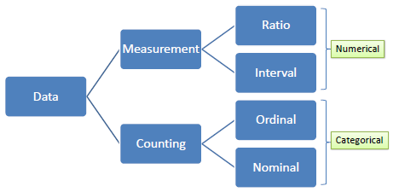
Data
Data is information typically the results of measurement (numerical) or counting (categorical). Variables serve as placeholders for data. There are two types of variables, numerical and categorical.
A numerical or continuous variable is one that can accept any value within a finite or infinite interval (e.g., height, weight, temperature, blood glucose, ...). There are two types of numerical data, interval and ratio. Data on an interval scale can be added and subtracted but cannot be meaningfully multiplied or divided because there is no true zero. For example, we cannot say that one day is twice as hot as another day. On the other hand, data on a ratio scale has true zero and can be added, subtracted, multiplied or divided (e.g., weight).
A categorical or discrete variable is one that can accept two or more values (categories). There are two types of categorical data, nominal and ordinal. Nominal data does not have an intrinsic ordering in the categories. For example, "gender" with two categories, male and female. In contrast, ordinal data does have an intrinsic ordering in the categories. For example, "level of energy" with three orderly categories (low, medium and high).

Slide 9
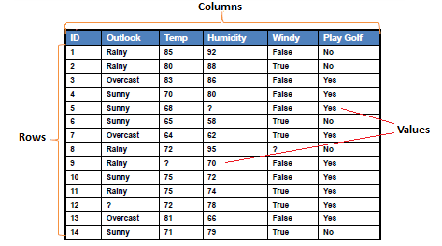
Dataset
Dataset is a collection of data, usually presented in a tabular form. Each column represents a particular variable, and each row corresponds to a given member of the data.
There are some alternatives for columns, rows and values.
Columns, Fields, Attributes, Variables
Rows, Records, Objects, Cases, Instances, Examples, Vectors
Values, Data
In predictive modeling, predictors or attributes are the input variables and target or class attribute is the output variable

Slide 10
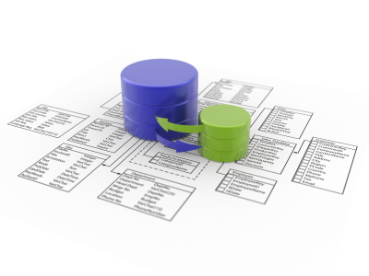
Database
Database collects, stores and manages information so users can retrieve, add, update or remove such information
Database presents information in tables with rows and columns
A table is referred to as a relation in the sense that it is a collection of objects of the same type (rows)
Data in a table can be related according to common keys or concepts, and the ability to retrieve related data from related tables is the basis for the term relational database
A Database Management System (DBMS) handles the way data is stored, maintained, and retrieved
Most data mining toolboxes connect to databases through
ODBC (Open Database Connectivity) or
JDBC (Java Database Connectivity) interfaces

Slide 11
SQL (Structured Query Language)
SQL is a database computer language for managing and manipulating data in relational database management systems (RDBMS)
SQL Data Definition Language (DDL) permits database tables to be created, altered or deleted. We can also define indexes (keys), specify links between tables, and impose constraints between database tables
CREATE TABLE : creates a new table
ALTER TABLE : alters a table
DROP TABLE : deletes a table
CREATE INDEX : creates an index
DROP INDEX : deletes an index
SQL Data Manipulation Language (DML) is a language which enables users to access and manipulate data
SELECT : retrieval of data from the database
INSERT INTO : insertion of new data into the database
UPDATE : modification of data in the database
DELETE : deletion of data in the database

Slide 12
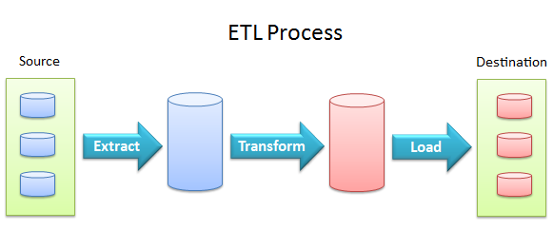
ETL (Extraction, Transformation and Loading)
ETL extracts data from data sources and loads it into data destinations using a set of transformation functions.
Data extraction provides the ability to extract data from a variety of data sources, such as flat files, relational databases, streaming data, XML files, and ODBC/JDBC data sources.
Data transformation provides the ability to cleanse, convert, aggregate, merge, and split data.
Data loading provides the ability to load data into destination databases via update, insert or delete statements, or in bulk.

Slide 13
3. Gather and Analyze additional Data
Add data that may not be “typical” but could help answer the question, including external data
The external data may not be usable or even attainable, but it will make you think

Slide 14
4. Start Data Reduction
Once you have this data, it may contain hundreds of independent variables
Data reduction can be tedious and time consuming, but we have a brain a macros to help
Start with your intuition and throw out the obvious
We often have business rules about data usage for different situations
Gender, age, and so on are often off the table, so we may be able to eliminate them
The more you study your data the easier this becomes.

Slide 15
5. Determine missing percentages.
Run macros that will rank order variables by %missing
Do not automatically dismiss a variable that has more than 50% missing elements
It may be important and you may find some way to augment it, impute it, or combine it with a like variable
Now you should have a much reduced list of variables

Slide 16
6. Determine Value of Information (VOI)
Take the list from step (5) and run a macro (or two) that provided the Value of Information with one or more metrics
I have included one for SAS in Appendix A
It is not yet refined and I need to add notes, and get the Excel output portion to work
In SPSS Modeler, I have built a mode that does this
You provide the input (your list of variables)
the model crunches them, and produced a reduced set that becomes input for you model, and the process is seamless.

Slide 17
Information Value
With information rich data, we may have a few 100 up to a couple of thousand variables of interest
Two information value metrics can be used for data reduction: Lift & Net Lift
Each requires that all numerical variables be equally binned
Algorithm in Pseudocode:
For Var_i = 1..N;
Run Identify_Var_type;
END;
No_bins = 6;
For Var_Type = “N”;
DO;
Run Bin_vars;
OD;
END;

Slide 18

Lift
This metric tells how much each variable contributes to explaining the response
Weight of Evidence (WOE)
Information Value (IV)
$$WOE=\text{ln}\left(\frac{\%resp_{i}}{\%non−resp_{i}}\right), i=1,2,…,k \text{where} k i\text{s} \text{the} \text{number} \text{of} \text{bin}s$$
$$IV=\sum_{i=1}^{k}{\left\{\left(\%resp_{i}− \%non−resp_{i}\right)∗WOE_{i}\right\}}$$

Slide 19
Net Lift
This metric tells how much each variable contributes to explaining the response when a control group C and treatment group T are used
Net Weight of Evidence (NetWOE)
Net Information Value (NIV)
$$Net WOE_{attribute}= WOE_{attribute}\left(TREATMENT\right)−WOE_{attribute}\left(CONTROL\right)$$
$$NIV =$$
$$\sum{\left((P(X=x|resp=1,T)P(X=x|resp=0,C)−P(X=x|resp=0,T)P(X=x|resp=1,C) )x NetWOE\right)}$$

Slide 20
7. Use VOI metrics to further reduce data
IV Rules of Thumb for evaluating the strength a predictor
Less than 0.02: unpredictive
0.02 to 0.1: weak
0.1 to 0.3: medium
0.3 +: strong

Slide 21
8. Run test for and examine collinearity
Some variables that are slightly correlated may be okay to use, and this is another spot where modeler judgment is employed

Slide 22
9. Determine you functional form
When you build you model, you must decide what functional form will be used, e.g., logistic regression, classification tree, etc.
The functional form for will depend primarily on the form/type of the response variable
The functional form may also be influenced my the phenomenon being modeled

Slide 23
Guidelines
Functional Form for Propensity Score Models
Response Variable Type | Parametric | Functional Form | Functional Assumptions
Binary | Fully | Logistic regression | Log-linear
Binary | Semi | Ensemble (logistic and neural network) | None
Binary/multinomial | Non | Neural network | None
Binary/multinomial | Semi (kernel function) | Support vector machine (SVM) | Linearly separable classes
Binary/multinomial | Non but underlying classifiers may be parametric | Meta-classifiers/boosting | None
Binary/multinomial | Non | CART/Decision tree | None for CART, some for other techniques

Slide 24
10. Build your model
Predictive modeling is the process by which a model is created to predict an outcome
If the outcome is categorical it is called classification and if the outcome is numerical it is called regression
Binary variables can be either categorical or numeric
For example, you can take Yes/No as Yes = 1 and No = 0
Descriptive modeling or clustering is the assignment of observations into clusters so that observations in the same cluster are similar
Finally, association rules can find interesting associations amongst observations

Slide 25
Decision Tree - Classification
Decision tree builds classification or regression models in the form of a tree structure. It breaks down a dataset into smaller and smaller subsets while at the same time an associated decision tree is incrementally developed
The final result is a tree with decision nodes and leaf nodes. A decision node (e.g., Outlook) has two or more branches (e.g., Sunny, Overcast and Rainy)
Leaf node (e.g., Play) represents a classification or decision
The topmost decision node in a tree which corresponds to the best predictor called root node
Decision trees can handle both categorical and numerical data.

Slide 26
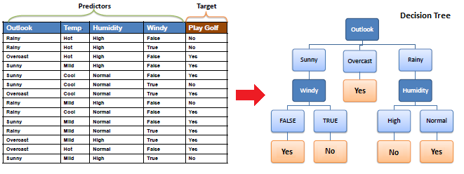
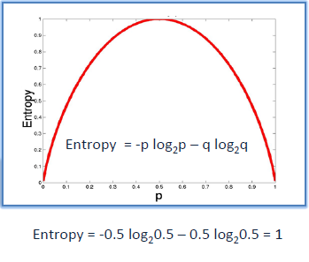
Decision Tree - Classification
The core algorithm for building decision trees called ID3 by J. R. Quinlan which employs a top-down, greedy search through the space of possible branches with no backtracking.
ID3 uses Entropy and Information Gain to construct a decision tree.

Slide 27
Logistic Regression
Logistic regression predicts the probability of an outcome that can only have two values
The prediction is based on the use of one or several predictors (numerical and categorical)
A linear regression is not appropriate for predicting the value of a binary variable for two reasons:
A linear regression will predict values outside the acceptable range (e.g. predicting probabilities outside the range 0 to 1)
Since the dichotomous experiments can only have one of two possible values for each experiment, the residuals will not be normally distributed about the predicted line.
On the other hand, a logistic regression produces a logistic curve, which is limited to values between 0 and 1.
Logistic regression is similar to a linear regression, but the curve is constructed using the natural logarithm of the “odds” of the target variable, rather than the probability.
Moreover, the predictors do not have to be normally distributed or have equal variance in each group.

Slide 28

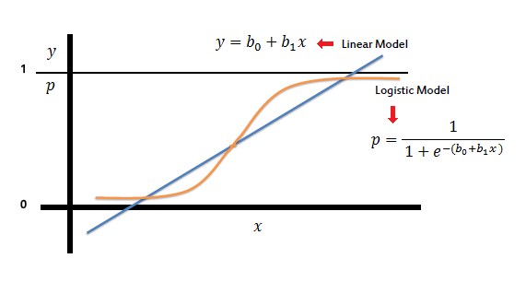

Logistic Regression
In the logistic regression the constant (b₀) moves the curve left and right and the slope (b₁) defines the steepness of the curve. By simple transformation, the logistic regression equation can be written in terms of an odds ratio.
Finally, taking the natural log of both sides, we can write the equation in terms of log-odds (logit) which is a linear function of the predictors.
The coefficient (b1) is the amount the logit (log-odds) changes with a one unit change in x.

Slide 29
Artificial Neural Network
An artificial neutral network (ANN) is a system that is based on the biological neural network, such as the brain
The brain has approximately 100 billion neurons, which communicate through electro-chemical signals
The neurons are connected through junctions called synapses
Each neuron receives thousands of connections with other neurons, constantly receiving incoming signals to reach the cell body
If the resulting sum of the signals surpasses a certain threshold, a response is sent through the axon
The ANN attempts to recreate the computational mirror of the biological neural network, although it is not comparable since the number and complexity of neurons and the used in a biological neural network is many times more than those in an artificial neutral network.

Slide 30
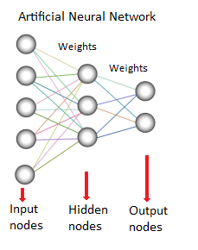
Artificial Neural Network
An ANN is comprised of a network of artificial neurons (also known as "nodes")
These nodes are connected to each other, and the strength of their connections to one another is assigned a value based on their strength:
inhibition (maximum being -1.0) or
excitation (maximum being +1.0)
If the value of the connection is high, then it indicates that there is a strong connection
Within each node's design, a transfer function is built in
There are three types of neurons in an ANN, input nodes, hidden nodes, and output nodes.

Slide 31
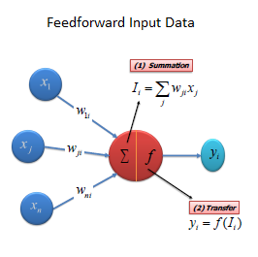
Artificial Neural Network
The input nodes take in information, in the form which can be numerically expressed
The information is presented as activation values, where each node is given a number, the higher the number, the greater the activation
This information is then passed throughout the network
Based on the connection strengths (weights), inhibition or excitation, and transfer functions, the activation value is passed from node to node
Each of the nodes sums the activation values it receives; it then modifies the value based on its transfer function
The activation flows through the network, through hidden layers, until it reaches the output nodes
The output nodes then reflect the input in a meaningful way to the outside world.

Slide 32
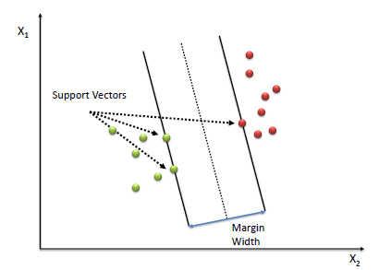
Support Vector Machine – Classification (SVM)
A Support Vector Machine (SVM) performs classification by finding the hyperplane that maximizes the margin between the two classes.
The vectors (cases) that define the hyperplane are the support vectors.

Slide 33
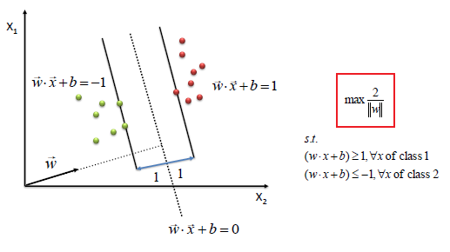
Support Vector Machine – Classification (SVM)
Algorithm
Define an optimal hyperplane: maximize margin
Extend the above definition for non-linearly separable problems: have a penalty term for misclassifications.
Map data to high dimensional space where it is easier to classify with linear decision surfaces: reformulate problem so that data is mapped implicitly to this space.

Slide 34
11. Examine your model results
Perform diagnostic test for fit, variable influence, collinearity, and so own
At this point you may want to either manually exclude some variable (effects) or add some back
Run your model again and repeat this process until you are happy with its performance and your ability to explain it

Slide 35
12. Run the model with model variable only
Remove all input variables that were not included in your model as, rerun it, and produce scoring code
If you are using SAS Enterprise Miner, port you score code to SAS EG and run it there—you should get the same results
You can also port the data from your regression node—that it the imputed, transform data—to R and run it there
Once again you should get the same of similar results.

Slide 36
13. Develop validation code
This will contain the code that gets your target and attribute/behavior variables, your scoring code, and the metrics you intend to compare

Slide 37
14. Perform out-of-time testing
Do this using profile dates occurring before and after the modeled profile data and evaluate the models performance
Do this with you validation code so that you have some metrics to compare

Slide 38
15. Evaluate the model performance
Validate using benchmarks and other techniques, and perform sensitivity analysis

Slide 39
16. Develop you model documentation
You should be doing this as you go along, so that you do not miss anything

Slide 40
Contact Information
E-mail: jeff@humalytica.com
LinkedIn: https://www.linkedin.com/in/jeffreystrickland
Web site: www.humalytica.com
Skype: jeffrey.strickland2

